Slide 1
IP ADDRESSING v4

Slide 2
It is an unique address which is used to identify a machine individually.
It is of 32-bit & divided into 4 octets.
It is written into decimal dotted notation i.e. w.x.y.z
It has been divided into number of classes i.e. Class A, Class B, Class C, Class D & Class E.
Note : > Class A, Class B & Class C is used for device addressing.
> Class D is used for Multicasting.
> Class E is used for Scientific research.
There are two types of IP Address
1. Classful IP Address – It follow classful rule.
2. Classless IP Address – It do not follow classful rule.

Slide 3
Classful Rule For Class A
- First octet first bit always ‘0’.
- Network Part = 8-bit, Host Part = 24-bit.
- Subnet Mask Always 255.0.0.0
----------------------------------------------------------------------------------------------------
Classful Rule For Class B
- First octet first two bit always ‘10’.
- Network Part = 16-bit, Host Part = 16-bit.
- Subnet Mask Always 255.255.0.0
----------------------------------------------------------------------------------------------------
Classful Rule For Class C
- First octet first three bit always ‘110’.
- Network Part = 24-bit, Host Part = 8-bit.
- Subnet Mask Always 255.255.255.0

Slide 4
IP Address is of two part : IP Address = Network Part + Host Part
Where, - Network Part integrate multiple host addresses.
- Host Part identify an individual machine.
Subnet Mask – It is used to identify network bit & host bit in an IP Address.
For Ex. SM = 255.0.0.0 i.e. 11111111.00000000.00000000.00000000
Where, 1 = On bit means belong to Network Part
0 = Off bit means belong to Host Part
Octet Range vary between 0 to 255.
00000000 = 0
11111111 = 255
So In the above example 8 bit is n/w part & 24 bit is host part.
Likewise, If SM = 255.255.255.0, then N/W Part = 24-bit, Host Part = 8-bit

Slide 5
Value of octet according to off bit & on bit
It applicable is for all octet.
00000000 – 0
10000000 – 128
11000000 – 192
11100000 – 224
11110000 – 240
11111000 – 248
11111100 – 252
11111110 – 254
11111111 – 255

Slide 6
Identifying Range, No. Of Network & No. Of Host per Network
Class A
1. Range :
- Write first octet two times & reserve the bit according to first classful rule.
- Make rest of bit firstly zero & then all one.
- Then convert into decimal.
00000000 0 0000000 0 0000000 = 0
00000000 0 0000000 0 1111111 = 127
So, Range = 0 to 127
Where, 0 = Invalid & 127 = Reserved for Loopback address
2. No. Of Network = 2^{n} Where, n = Total n/w bit – reserved bit i.e. 8 – 1 = 7
2⁷ = 128
3. No. of Host / Network = 2^{n} - 2 Where, n = Total off bit
2²⁴ -2 = 16777214

Slide 7
Identifying Range, N0. Of Network & No. Of Host per Network
Class B
1. Range :
- Follow the previous method.
00000000 10 000000 10 000000 = 128
00000000 10 000000 10 111111 = 191
So, Range = 128 to 191
2. No. Of Network = 2^{n} Where, n = Total n/w bit – reserved bit i.e. 16 - 2 = 14
2¹⁴ = 16384
3. No. of Host / Network = 2^{n} - 2 Where, n = Total off bit
2¹⁶ - 2 = 65534

Slide 8
Class C
1. Range :
- Follow the previous method.
00000000 110 00000 110 00000 = 192
00000000 110 00000 110 11111 = 223
So, Range = 192 to 223
2. No. Of Network = 2^{n} Where, n = Total n/w bit – reserved bit i.e. 24 - 3 = 21
2²¹ = 2097152
3. No. of Host / Network = 2^{n} - 2 Where, n = Total off bit
2⁸ - 2 = 254
Note : Class D = 224 to 239
Class E = 240 to 255

Slide 9
Sub netting
It is the process of dividing a large network into smaller sub network.
It is done using two method :
1. Fixed Length Subnet Mask ( FLSM )
- In this method, all subnet have same subnet mask and no. of host as well.
2. Variable Length Subnet Mask ( VLSM )
- In this method, every subnet have different subnet mask and no. of host.
Advantage
Conserve IP Address
Disadvantage
In case of single network, only three steps are required
> Source Host - Destination Network - Destination Host - Process
In case of subnetting four steps are required
> Source Host - Destination Network – Proper Subnet – Destination Host - Process

Slide 10
Class C sub netting
Ex. 1 192.168.1.0 /26 [ N/W Add = 192.168.1.0 & CIDR Value = 26 ]
It indicate how It is known as
many bits are CIDR value. [ CIDR = Classless Inter Domain Routing ]
turned on.
If CIDR value is given, calculate subnet mask first & vice -versa
To calculate subnet mask, write all 32-bit first & then make bits on i.e. equal to given CIDR value. And then convert into decimal number system.
00000000.00000000.00000000.00000000
11111111.11111111.11111111.11000000
So, Subnet Mask = 255.255.255.192
Likewise, If CIDR = 28
11111111.11111111.11111111.11110000
i.e. Subnet Mask = 255.255.255.240

Slide 11
After calculating subnet mask, we need to solve following these five questions :-
1. No. of Subnet = 2n where, n = no. of extra on bit
In above example, n = 2 [ CIDR – Default on bit i.e. 26 – 24 ]
So, No. of Subnet = 22 = 4
2. No. of Host / Subnet = 2n where, n = no. of total off bit
In above example, n = 6 [ Total bit – CIDR i.e. 23 - 26 ]
No. of Host / Subnet = 26 -2 = 62
3. Block Size = 256 – XYZ where, XYZ = calculated value of extra on bit
i.e. 256 – 192 = 64
4. Valid Subnets
- First subnet will be itself i.e. given network address.
or start wit zero from rightmost host octet.
- To calculate next subnet, add block size value in that octet in which extra bit is on.
- Continue to add until the calculated value of extra on bit match.

Slide 12
5. Broadcast address : It is number just before the next subnet. [Next Subnet -1]
Subnet Address | 192.168.1.0 | 192.168.1.64 | 192.168.1.128 | 192.168.1.192
First Valid Host Add Last Valid Host Add | 192.168.1.1 192.168.1.2 192.168.1.3 - - - 192.168.1.62 | 192.168.1.65 192.168.1.66 192.168.1.67 - - - 192.168.1.126 | 192.168.1.129 192.168.1.130 192.168.1.133 - - - 192.168.1.190 | 192.168.1.193 192.168.1.194 192.168.1.195 - - - 192.168.1.254
Broadcast Address | 192.168.1.63 | 192.168.1.127 | 192.168.1.191 | 192.168.1.255

Slide 13
IP ADDRESS
PRIVATE IP PUBLIC IP
- Used in LAN - Used on globe (internet)
- Free to use - Need to purchase
- Not registered - Registered with IANA ( Now, ICANN)
ICANN manage the distribution of IP address. ICANN
It has been created RIR per continent.
And under RIR, LIR/NIR (ISP) work.
India comes into ASIA. (For Asia, RIR = APNIC) RIR
IANA – Internet Assigned Numbers Authority LIR/NIR
ICANN – Internet Corporation for Assigned Names & Numbers
RIR – Regional Internet Registry CUSTOMER
LIR / NIR – Local / National Internet Registry
ISP – Internet Service Provider
APNIC – Asia Pacific Network Information Centre

Slide 14
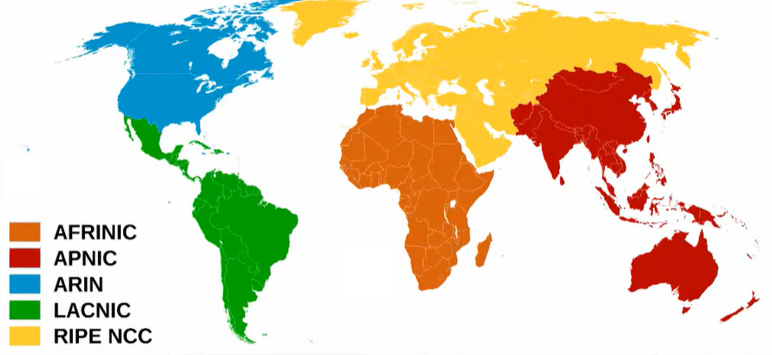

Slide 15
Private IP Address Range
Class A = 10.0.0.0 to 10.255.255.255
Class B = 172.16.0.0 to 172.31.255.255
Class C = 192.168.0.0 to 192.168.255.255
-------------------------------------------------------------------------------------------------------------------------------------------
- Loopback Address = 127.0.0.0 to 127.255.255.255
- APIPA = 169.254.0.0 to 169.254.255.255
- Reserved by IANA for Local Identification = 0.0.0.0 to 0.255.255.255
- Used for default routing = 0.0.0.0
-------------------------------------------------------------------------------------------------------------------------------------------
Types of Public IP address
1. Static – Each time we connect to internet, get same IP address.
2. Dynamic – Each time we connect to internet, get different IP address.
-------------------------------------------------------------------------------------------------------------------------------------------
Types of ISP :
A) Tier – 1
B) Tier – 2
C) Tier – 3

Slide 16
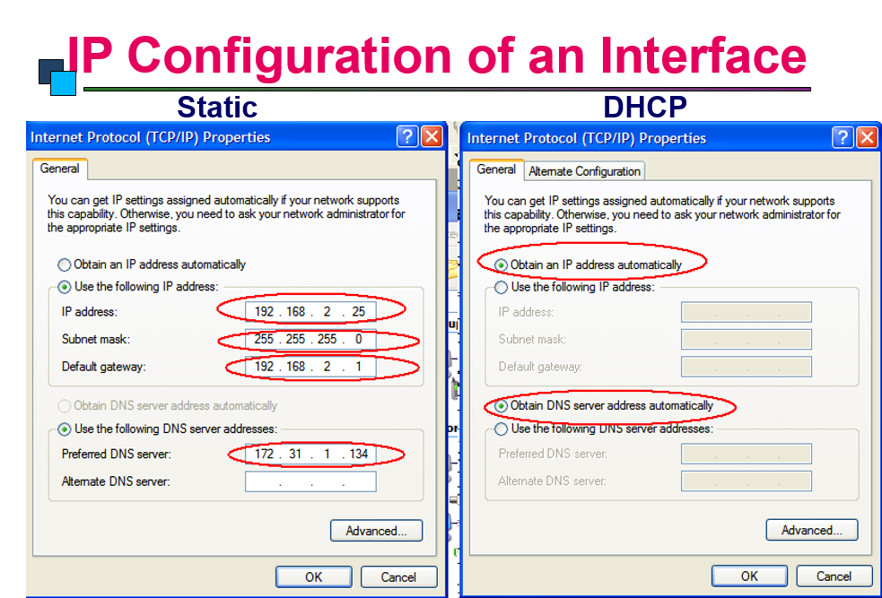

Slide 17
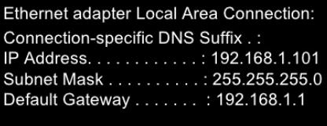
How to determine an IP Address ?
Press Win Key + R
Type cmd & enter
Type ipconfig & press enter
This should give you information similar to what is shown below :

Slide 18
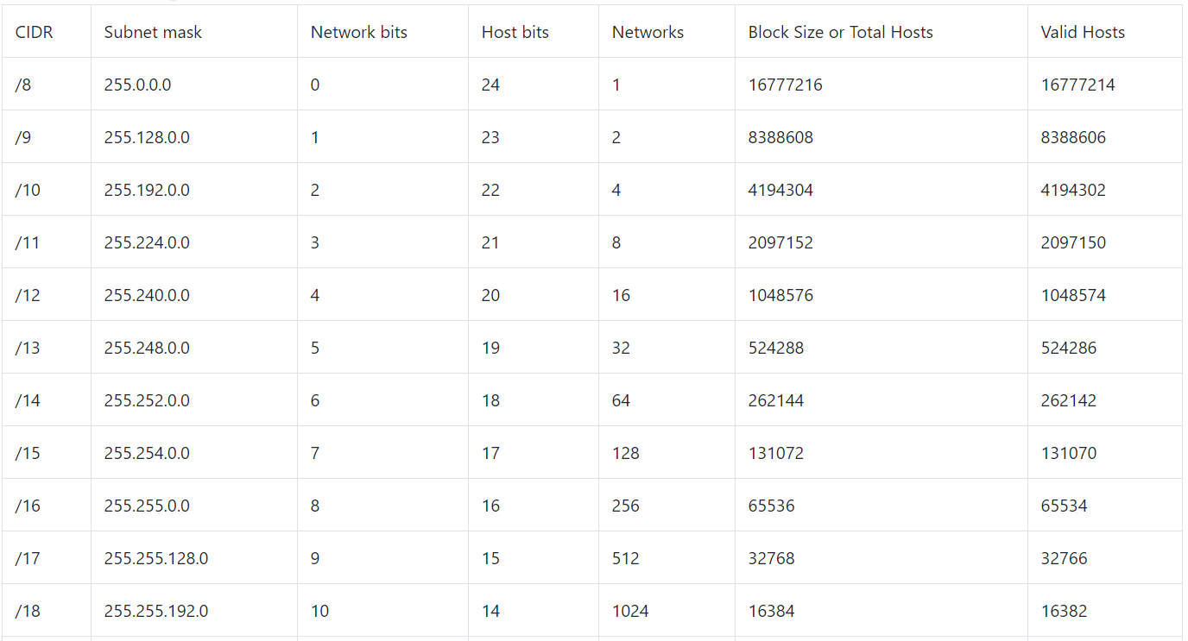
Class a sub netting chart

Slide 19
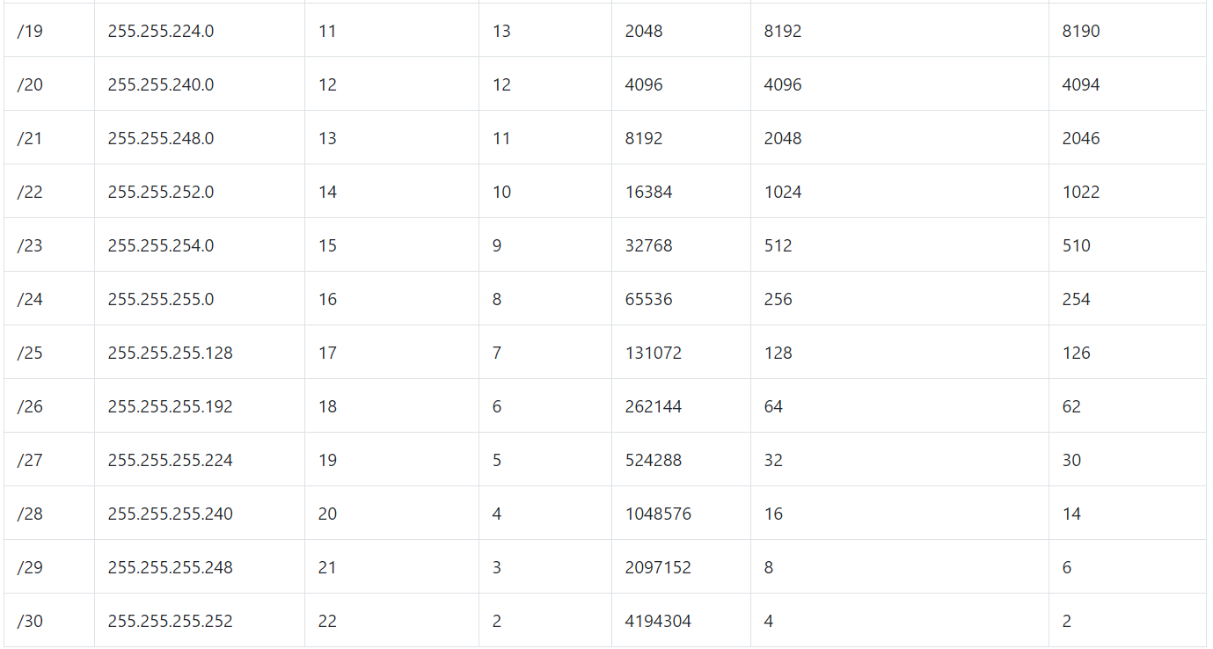

Slide 20
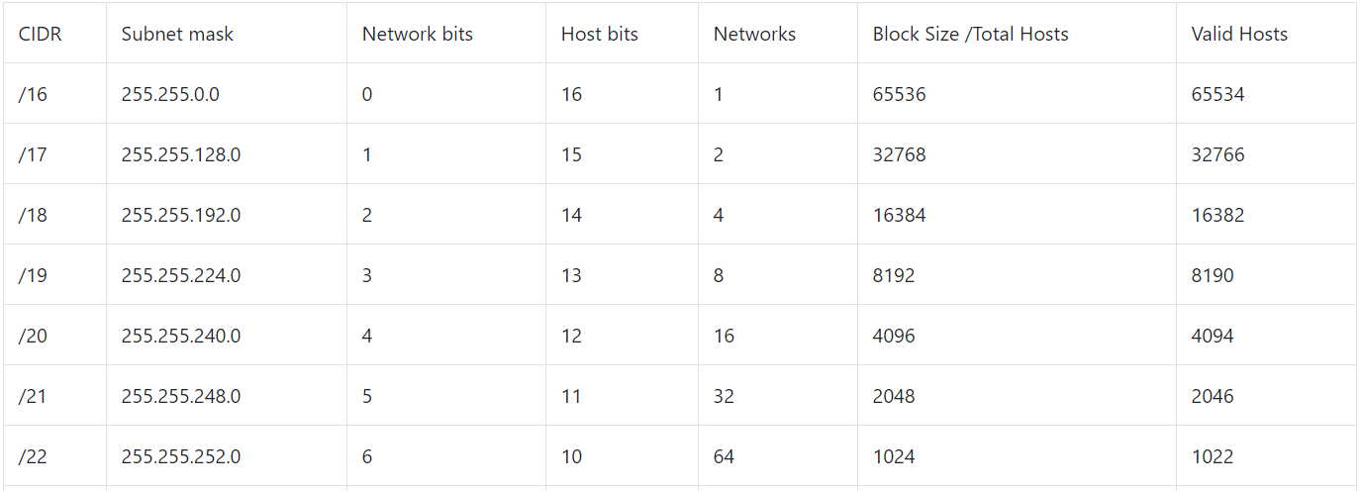
Class b sub netting chart

Slide 21
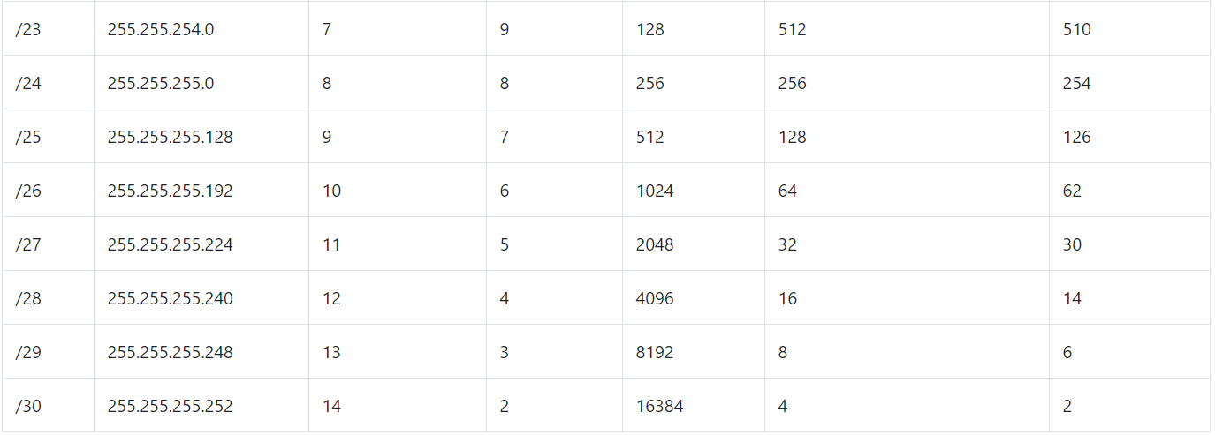

Slide 22
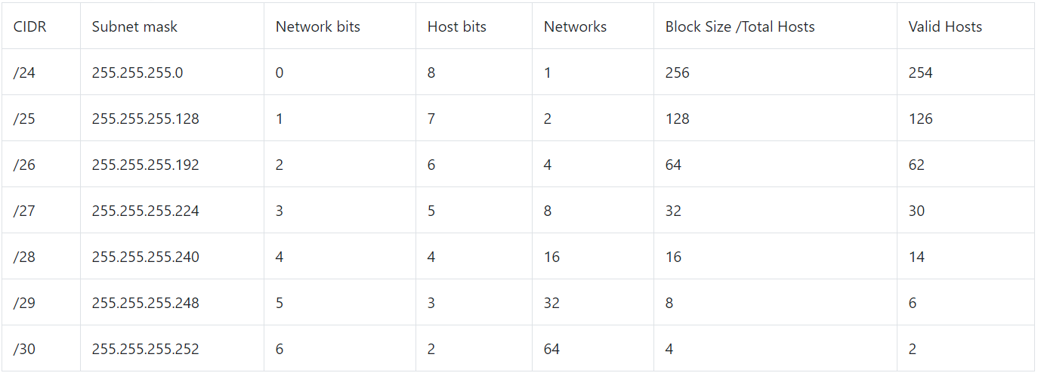
Class C sub netting chart

Slide 23
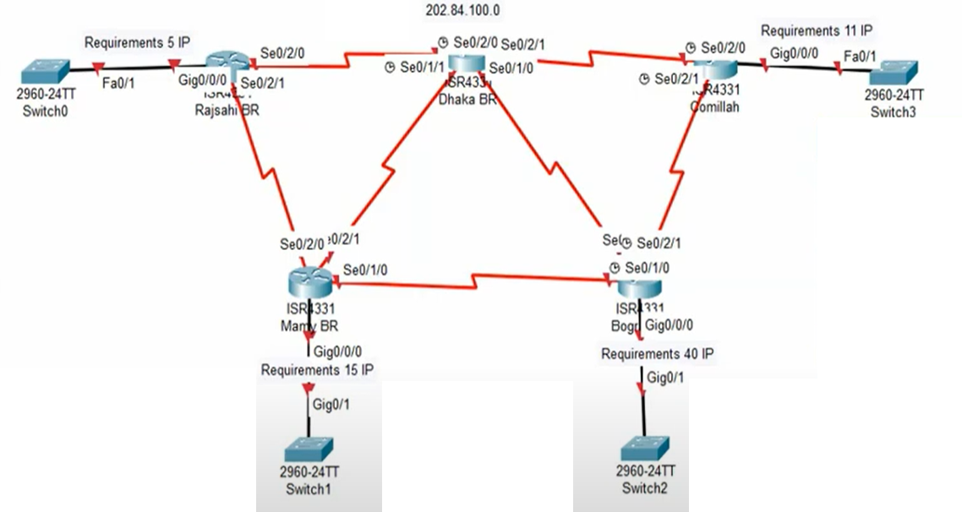
VLSM (Variable Length Subnet Mask) - Topology

Slide 24
VLSM Worksheet Design
Network | No. of Host | Block Size | CIDR Value | Subnet MAsk
A | 5 | 8 | /29 | 225.255.255.248
B | 2 | 4 | /30 | 255.255.255.252
C | 2 | 4 | /30 | 255.255.255.252
D | 11 | 16 | /28 | 255.255.255.240
E | 2 | 4 | /30 | 255.255.255.252
F | 40 | 64 | /26 | 255.255.255.192
G | 2 | 4 | /30 | 255.255.255.252
H | 15 | 32 | /27 | 255.255.255.224
I | 2 | 4 | /30 | 255.255.255.252
J | 2 | 4 | /30 | 255.255.255.252
K | 2 | 4 | /30 | 255.255.255.252

Slide 25
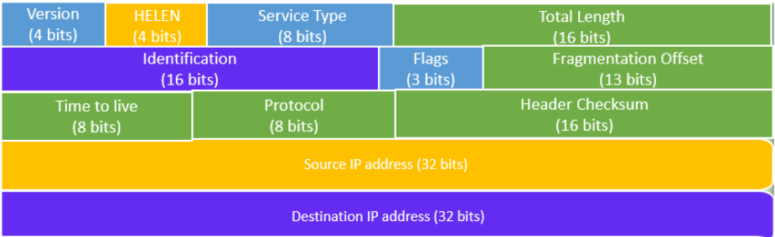
IPv4 Header

Slide 26
Version – It is of 4-bits & always set to 0100 which indicate 4.
IHL – It is 4 bit in size. IHL = IHL Value * 4 [Pure Received Data = Received data – IHL]
- IHL must be between 20 to 60 Bytes. [IHL value is between 5 to 15]
Type of Service – The 8-bit ToS field traditionally uses 3 bits for IP Precedence.
- The newer redefinition of the ToS field uses a 6-bit DSCP (Differentiated Services Code point) field and a 2-bit ECN (Explicit Congestion Notification) field to identify the level of service a packet receives in the network.
Identifier, flags, and fragment offset : - As an IP packet moves through the Internet, it might need to cross a route that cannot handle the size of the packet.
- The packet will be divided, or fragmented, into smaller packets and reassembled later. These fields are used to fragment and reassemble packets.
Total Length – It is measured in bytes that specifies the length of IP packet.
- It include IP header length & user data (payload).
- It is of 16-bit i.e. maximum size of IP packet may be 0 to 65535 bytes.

Slide 27
TTL – It indicate how long data will be live in the network.
- It is of 8-bit i.e. 0 to 255.
- The datagram will be discarded, when TTL value become zero.
Protocol – If any protocol from upper layer protocol is used, they are mentioned here.
- For example, 6 number indicate TCP & 17 is used to denote UDP.
Header Checksum – It is used to check the header for any errors.
Source Address : The source address is a 32-bit address of the source used for the IPv4 packet.
Destination address : The destination address is also 32 bit in size stores the address of the receiver.

Slide 28
Fragmentation In IPv4
Identification : 16-bit
- It is used to identify datagram by receiver that they belong to same packet.
Flag : 3-bit
Fragment Offset
- It indicate how many bytes ahead a packet.
- Offset Value = Total Pure Data Ahead of Packet / 8
MS bit (reserved) | DF (Do Not Fragment) | MF (More Fragment)
Always set to ‘0’ | If 0 – there is fragmentation 1 – No fragmentation | If 0 – Last packet 1 – More packet

Slide 29
Ex. A datagram of 3000 Byte ( 20 B = IP Header & 2980 = IP Payload ) reached at router and it must be forwarded to link with the MTU of 500 . How many fragments will be generated & also calculate value for MF, Offset & total length.
Fragments = Total Data / Data to be sent over the link
Where, Total Data = 3000 B – 20 B = 2980 B
Data to be sent over the link = 500 B – 20 B = 480 B
So, Fragments = 2980 / 480 = 6.20 [approx 7 fragments]
Let’s suppose 7 packets are :
P7 P6 P5 P4 P3 P2 P1
Total Length : 120 + 20 480 + 20 480 + 20 480 + 20 480 + 20 480 + 20 480 + 20
MF bit : 0 1 1 1 1 1 1
Offset : 360 300 240 180 120 60 0

Slide 30
Verify IP parameters for Client OS
(Windows, Mac OS, Linux)

Slide 31
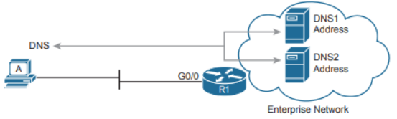
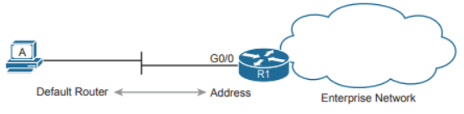
Whether learned using DHCP or not, every host that uses IP version 4 needs to have some settings to work correctly.
To work correctly, an IPv4 host needs to know these values:
■ DNS server IP addresses
■ Default gateway (router) IP address
■ Device’s own IP address
■ Device’s own subnet mask
- The host must know the IP address of one or more DNS
servers to send the servers’ name resolution requests.
Each endpoint needs to know the IP address of a
router that resides in the same subnet.
- The endpoint uses that router as its default router or default gateway.

Slide 32
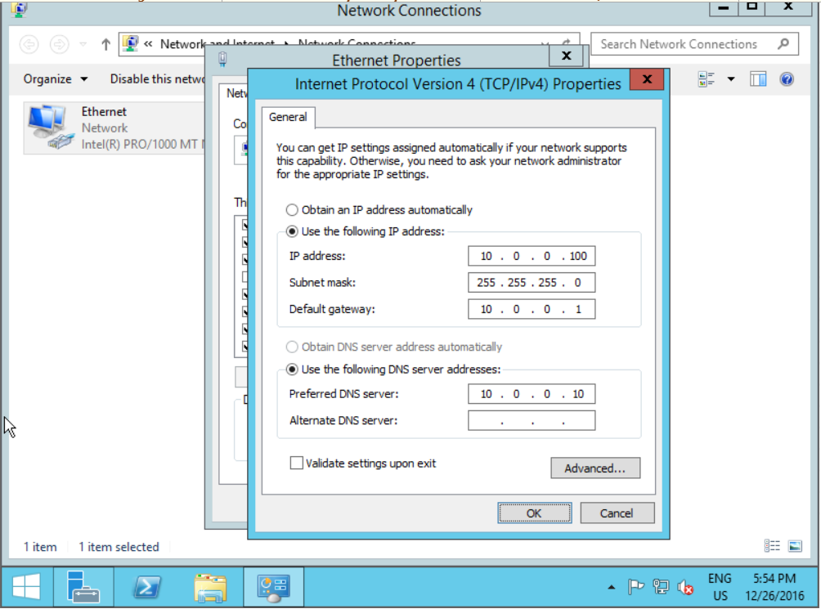
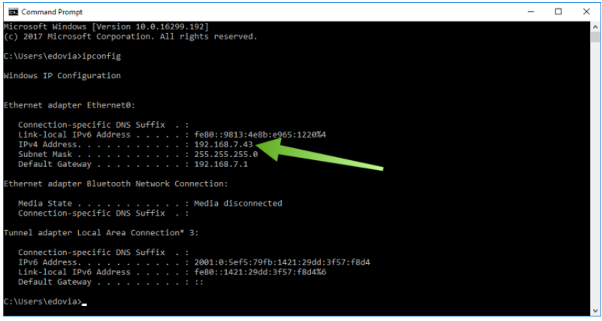
Host IP Settings on Windows

Slide 33
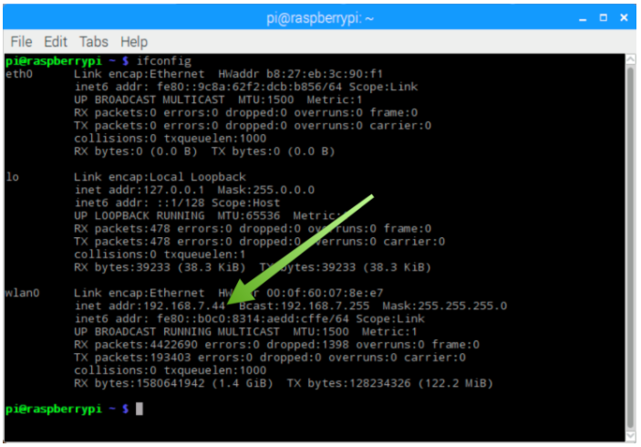
Host IP Settings on Linux

Slide 34
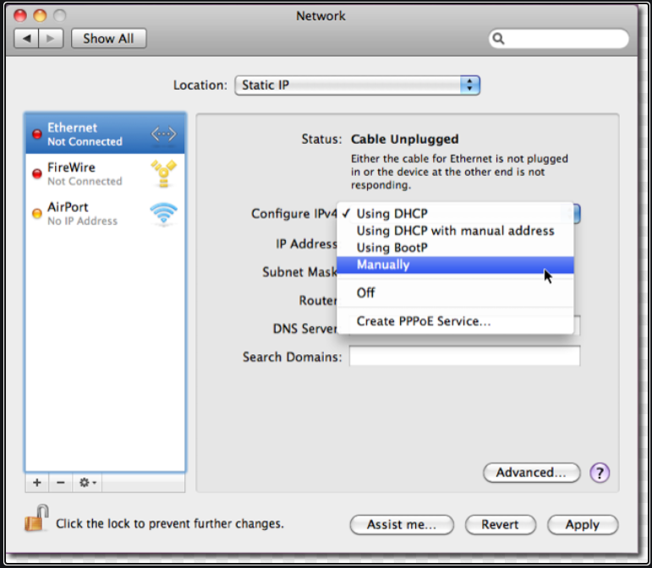
Host IP Settings on Linux

